Slide 1
CRACK SEGMENTATION FOR MARBLE SURFACE ANALYSIS

Slide 2
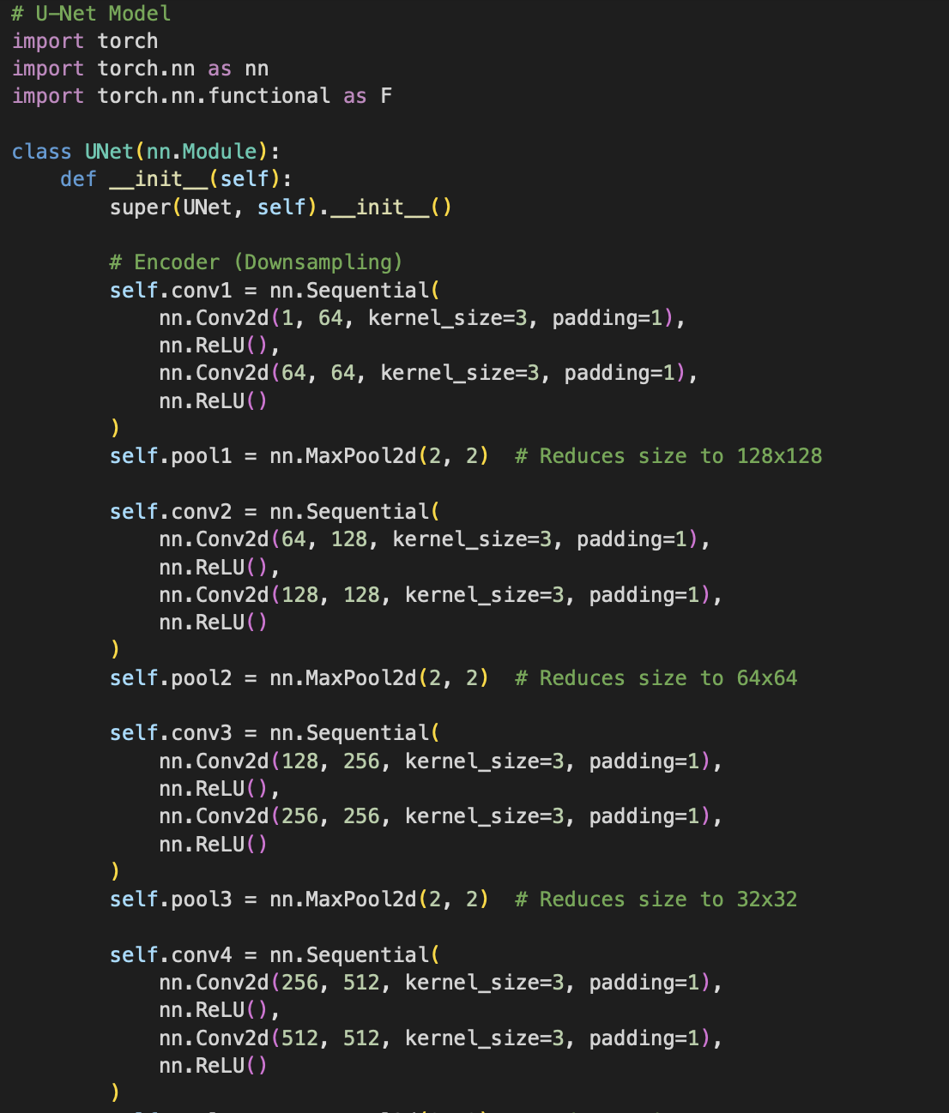
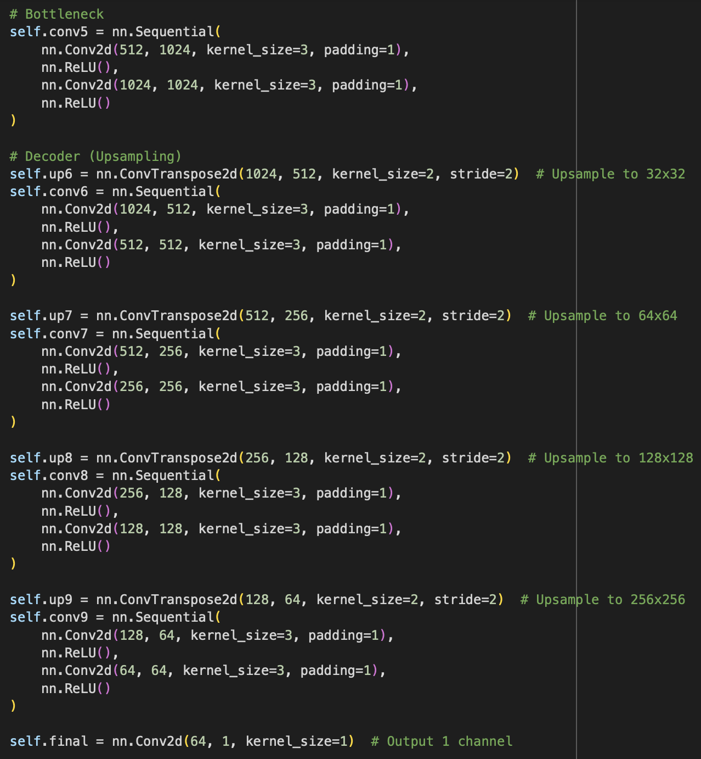
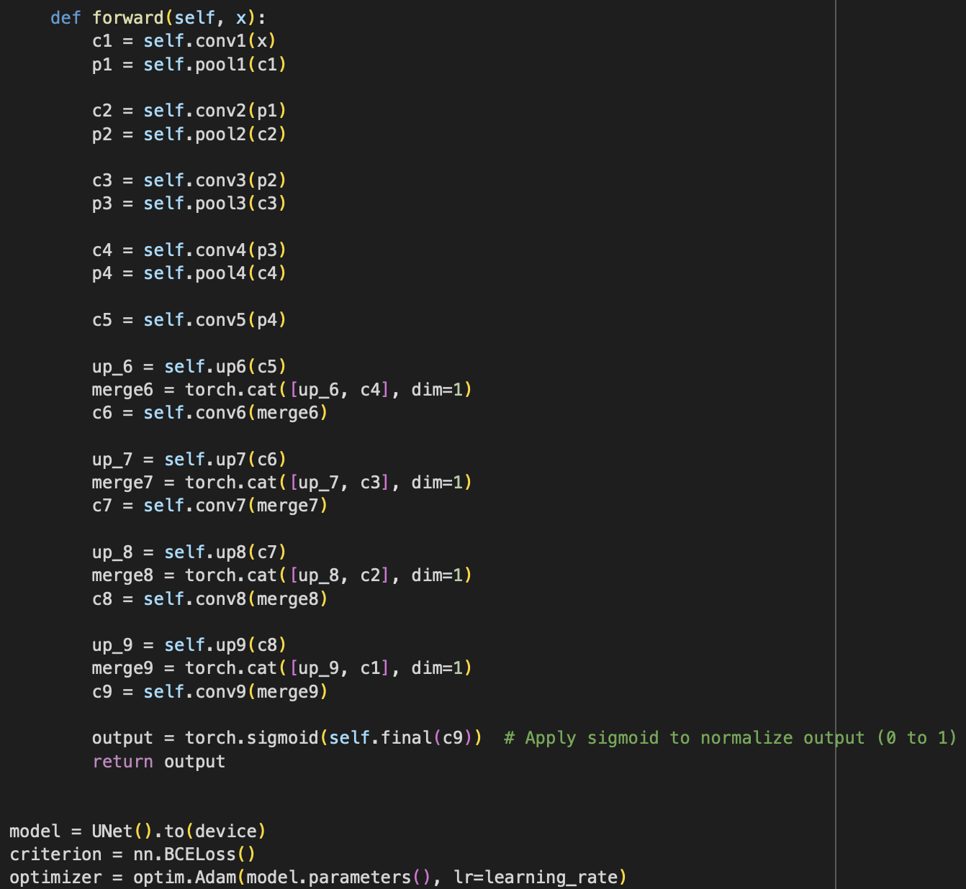
STEP-11- TRAINING THE DATASET
U-Net Model is used to train the data
Encoder (Downsampling the size of the images)
Decoder (Upsampling the size of the images)

Slide 3
STEP-11- TRAINING THE DATASET
U-Net Model is used to train the data
Encoder (Downsampling the size of the images)
Decoder (Upsampling the size of the images)

Slide 4
STEP-11- TRAINING THE DATASET
U-Net Model is used to train the data
Encoder (Downsampling the size of the images)
Decoder (Upsampling the size of the images)

Slide 5
STEP-1- WEB SEARCHING
RESEARCH PAPER
https://www.researchgate.net/publication/364358656_Towards_Robotic_Marble_Resin_Appl
ication_Crack_Detection_on_Marble_Using_Deep_Learning#pf6
REFERENCE PROJECTS
https://github.com/yhlleo/DeepSegmentor
(A Pytorch implementation of DeepCrack and RoadNet projects)
https://github.com/s9xie/hed
(develop a new edge detection algorithm, holistically-nested edge detection (HED))
https://www.kaggle.com/code/gcdatkin/concrete-crack-image-detection/notebook
(Concrete cracks detection. Used TensorFlow CNN to make our predictions)
https://github.com/yhlleo/DeepCrack
https://github.com/MachineLearningVisionRG/genAI-marble_cracks

Slide 6
STEP-2- PROJECT BREAKDOWN
1. Pre-Filling Inspection (Defect Detection)
● Goal: Identify cracks, pits, and uneven surfaces on raw stone slabs.
● Process:
○ Capture high-resolution images of the raw stone using a RGB camera.
○ Apply image processing (OpenCV) to detect surface defects:
■ Edge Detection (Canny, Sobel)
■ Texture Analysis (GLCM, Fourier Transform)
■ Deep Learning Model (CNN) trained on defect images
○ Highlight defective areas on a screen for operator guidance.
○ Store slab image and detected defect areas in the database.
● Technology:
○ High-resolution RGB Camera
○ OpenCV-based image processing
○ Deep Learning (CNN, ResNet, EfficientNet) for defect classification.

Slide 7
2. Resin Application by Operator
● Goal: Ensure operator applies resin to detected defective areas.
● Process:
1. Operator follows screen guidance to apply resin.
2. Resin is applied manually or automatically.
3. Curing process (drying/hardening) begins.
3. Post-Filling Inspection (Resin Verification)
● Goal: Check if resin has been applied uniformly and completely.
● Process:
○ Capture another post-filling image of the slab.
○ Compare before and after images:
■ Ima ge Subtraction (Detect changes in texture and color).
■ Texture Analysis (Check smoothness and uniformity).
■ AI Model (Classify “Correct” or “Incorrect” resin application).
○ If resin is missing/uneven, notify the operator for reapplication.
● Technology:
○ Image Processing (OpenCV)
○ Deep Learning (CNN or ResNet)
○ Optional: Depth Sensors (ToF, LiDAR) for height difference detection

Slide 8
4. Slab Tracking &amp; Numbering (80 Slabs per Stone)
● Goal: Assign unique ID to each slab and track quality.
● Process:
○ After cutting, assign a QR Code / Barcode to each slab (1-80).
○ Store resin application data per slab in a database.
○ Each slab has an inspection status (Pass/Fail).
● Technology:
○ QR Code/Barcode Tracking System
○ Database (SQL/NoSQL) for slab data storage
○ Raspberry Pi / Industrial PC for tracking system
5. Final Inspection &amp; Customer Database
● Goal: Store high-quality images of finished slabs for customers to review.
● Process:
○ Capture a final high-resolution image of each slab after curing.
○ Store images in a cloud/local database.
○ Customers can view slabs before purchase via a web portal.
● Technology:
○ Cloud / Local SQL Database
○ Web Interface (Optional) for customers to view slabs
○ User Interface for final approval (touchscreen or display)

Slide 9
STEP-3- SEARCHING FOR DATASETS
1. Stone & Marble Surface Defect Detection
● Marble Surface Defects Dataset (Kaggle)
○ Contains annotated images of marble slabs exhibiting cracks, holes, and
surface impurities.
○ Suitable for training segmentation and classification models.
● SDNET2018 – Concrete Crack Dataset (NIST)
○ Comprises 56,000 images of cracks in concrete and stone surfaces.
○ Valuable for developing crack detection models adaptable to marble slabs.
● CrackForest Dataset
○ Features 118 high-resolution images of surface cracks, which can be used for
marble defect detection.
● DeepCrack Dataset
○ Provides annotated crack images for training deep learning models,
particularly useful for segmentation tasks.
● Synthetic Crack Dataset (SCrack)
○ Utilizes Generative Adversarial Networks (GANs) to create diverse crack
patterns on marble-like surfaces.
○ Effective for dataset augmentation and improving model robustness.

Slide 10
2. Resin Application Quality Control
● Industrial Coating Defect Dataset (IEEE Xplore)
○ Contains images of coating defects, including improper application and
surface inconsistencies.
○ Relevant for quality control in resin coating processes.
● Kolektor SDD2 – Surface Defect Detection
○ Industrial dataset featuring images of coated surfaces with manufacturing
Defects.
○ Can assist in identifying resin streaks, uneven layers, missing spots, and
air bubbles.
● Steel Surface Defect Dataset (NEU Surface)
○ Includes images of scratches, pitting, and surface deformities.
○ Useful for generalizing defect detection models across various materials,
including resin-coated marble.
● Wood Coating & Varnish Defect Dataset (Mendeley Data)
○ High-resolution images of wooden surfaces with coating imperfections.
○ Can be adapted for resin application defect detection on marble surfaces.
● Paint Quality Control Dataset (Kaggle)
○ Features images of uneven coatings, bubble formations, and surface
Inconsistencies.
○ Applicable for resin application quality assurance.

Slide 11
3. Final Inspection & Customer Database Management
● Stanford Online Products Dataset (Stanford CVGL)
○ Useful for developing image-based product tracking and organization systems for finished marble slabs.
● Marble Slab Classification Dataset
○ Contains labeled images of different types of marble slabs.
○ Ideal for organizing slabs within a customer-facing database.
● Tile & Marble Classification Dataset (Kaggle)
○ Includes high-resolution images of various marble textures and materials.
○ Can be leveraged for automated classification after resin application.

Slide 12
STEP-4- FINALISING THE DATASET
Surface Crack Detection Dataset (Kaggle)
https://www.kaggle.com/datasets/arunrk7/surface-crack-detection
Content of dataset
The datasets contains images of various concrete surfaces with and without crack. The image data are divided into two as negative (without crack) and positive (with crack) in separate folder for image classification. Each class has 20000 images with a total of 40000 images with 227 x 227 pixels with RGB channels. The dataset is generated from 458 high-resolution images (4032x3024 pixel) with the method proposed by Zhang et al (2016). High resolution images found out to have high variance in terms of surface finish and illumination condition. No data augmentation in terms of random rotation or flipping or tilting is applied.

Slide 13
STEP-5- FINE TUNING THE DATASET
Fine-tuning a dataset refers to the process of making small but important adjustments to a pre-existing model by training it on a specific dataset. So, based on the requirements of our project, dataset is fine tuned.

Slide 14
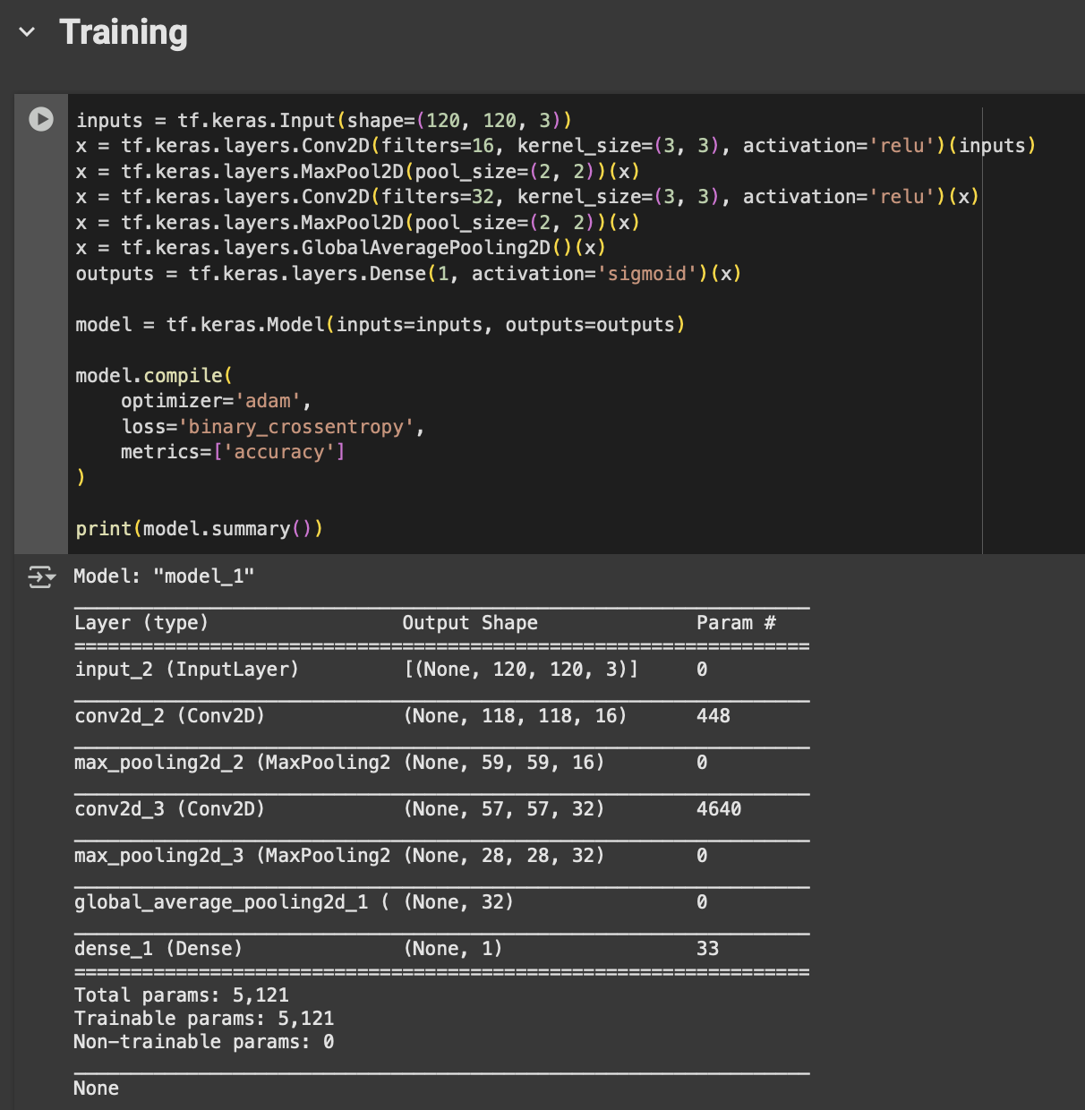
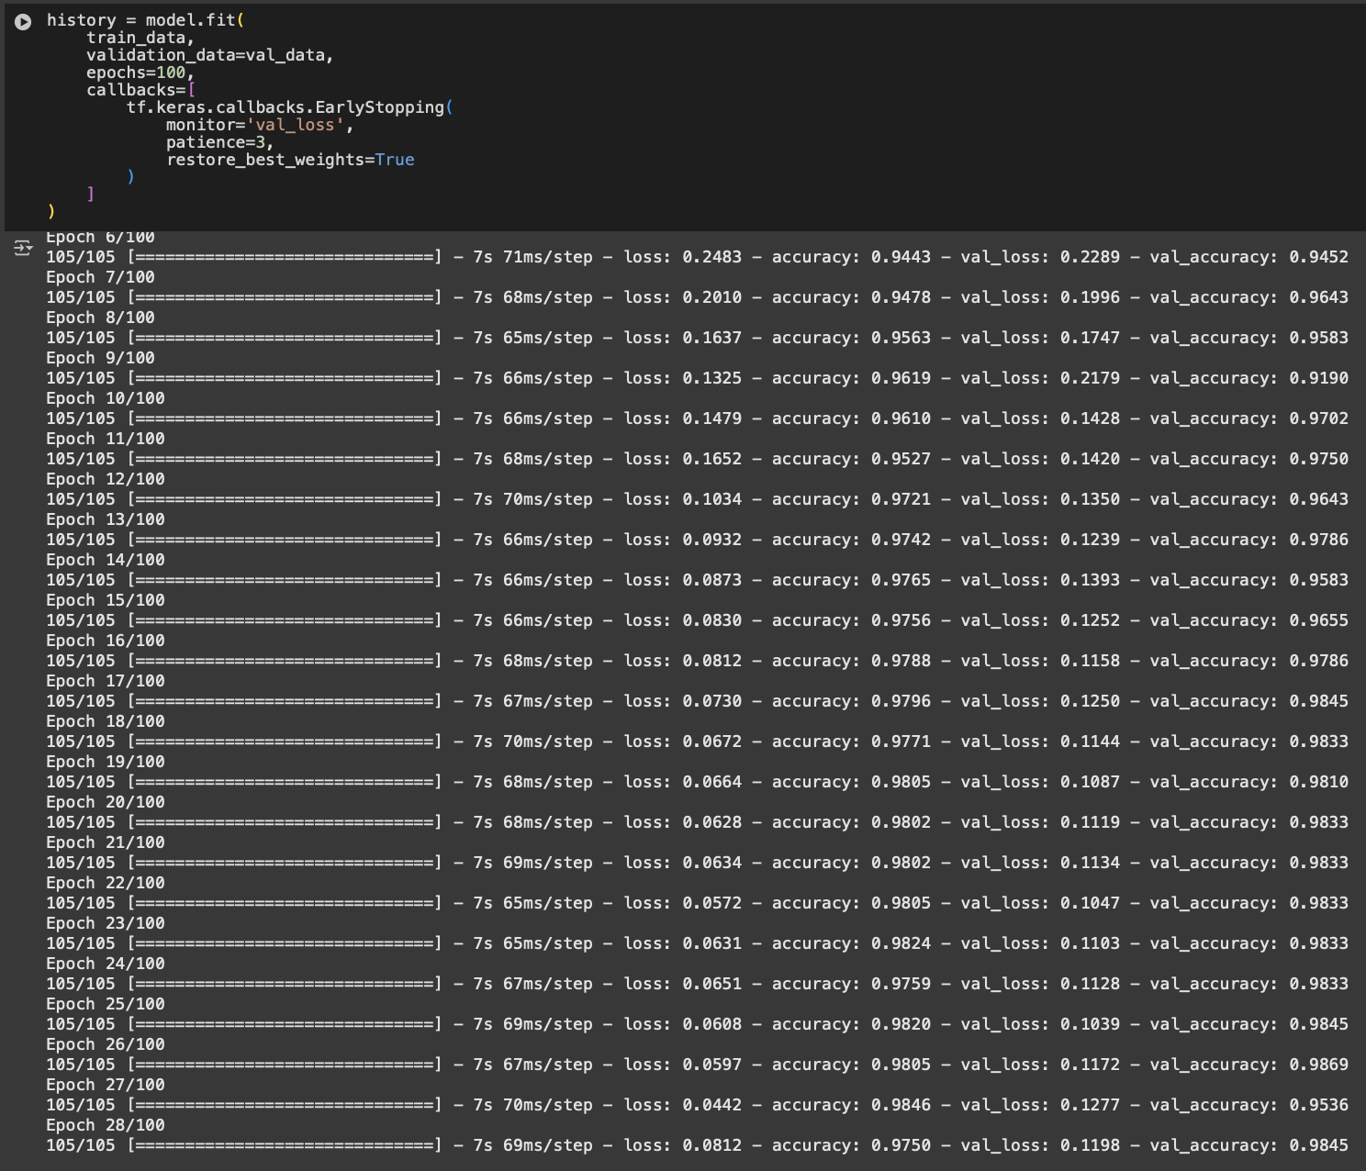
STEP-6- TRAINING THE MODEL
TRAINING ACCURACY- 98.45%

Slide 15
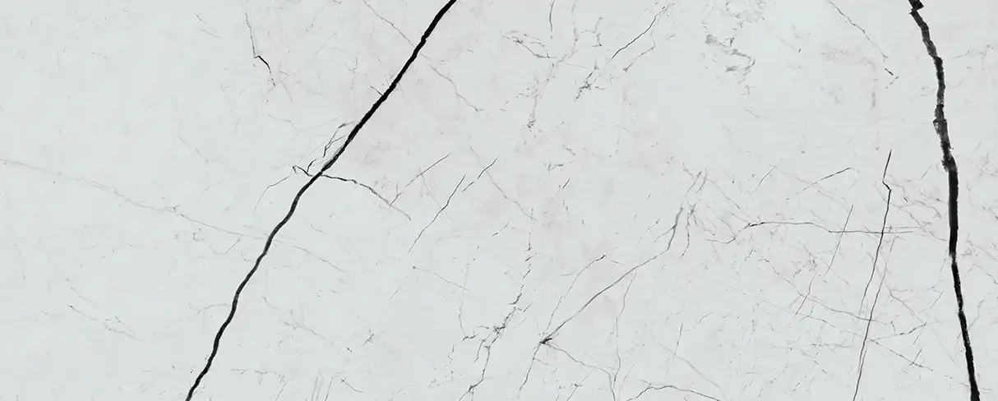
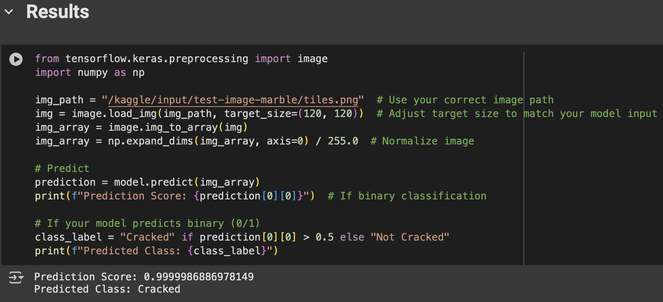
STEP-7- TESTING THE MODEL
INPUT IMAGE-
OUTPUT-
The model has successfully detected that the input image is a cracked marble. PREDICTED ACCURACY - 99.99%

Slide 16
STEP-8- GENERATING THE BOUNDING BOXES OF THE INPUT IMAGE
LabelImg (For manual bounding box annotation)- https://github.com/HumanSignal/labelImg
Roboflow (Automated annotation and dataset preparation)- https://roboflow.com/
Bounding box by ResNet50- https://www.kaggle.com/code/shivamb/objects-bounding-boxes-using-resnet50-imageai
Crack Detection- https://www.kaggle.com/code/hrushikeshdongre/crack-detection

Slide 17
PROBLEM FACING
The model I have used is only for the detection of the marble that is it cracked or not cracked. However, for further image detection we need to generate a model which generated the Grayscale image of the cracks on the marble.

Slide 18
STEP-9- FINDING THE CLASSIFIED DATASET
Deep Crack Dataset (GitHub)
https://github.com/yhlleo/DeepCrack/tree/master?tab=readme-ov-file
Content of dataset
We established a public benchmark dataset with cracks in multiple scales and scenes to evaluate the crack detection systems. All of the crack images in our dataset are manually annotated.

Slide 19
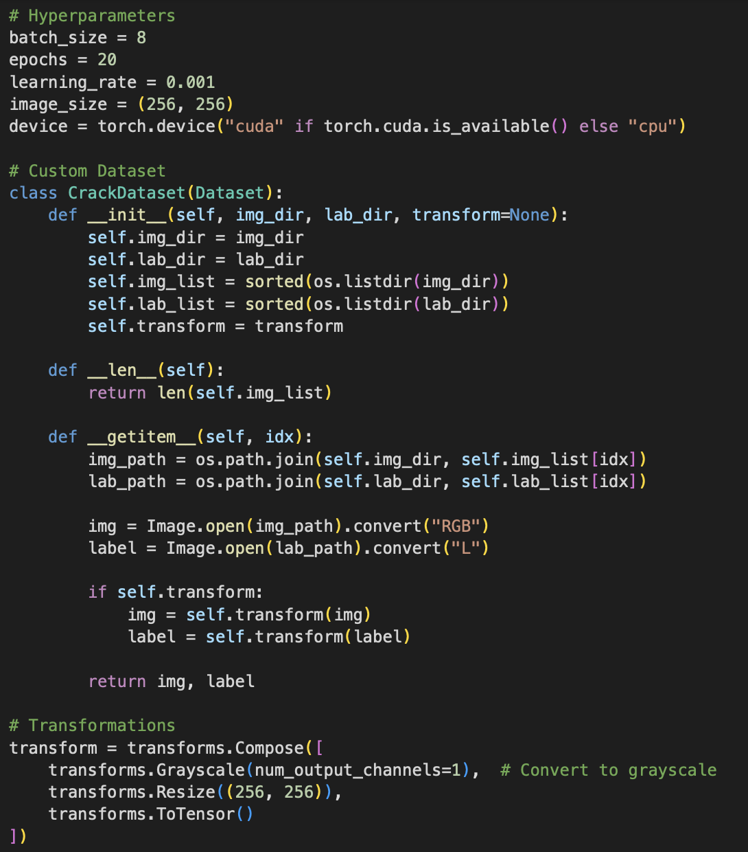
STEP-10- FINE TUNING THE DATASET
Setting the hyperparameters
Convert it into grayscale
Resizing the images

Slide 20
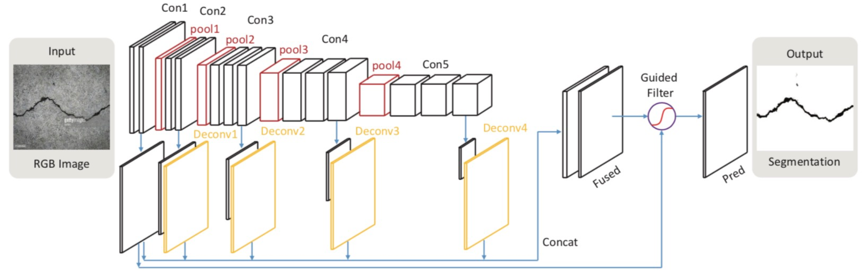
Deep Crack: A Deep Learning Framework for Crack Segmentation

Slide 21
STEP-11- TRAINING THE DATASET
U-Net Model is used to train the data
Encoder (Downsampling the size of the images)
Decoder (Upsampling the size of the images)

Slide 22
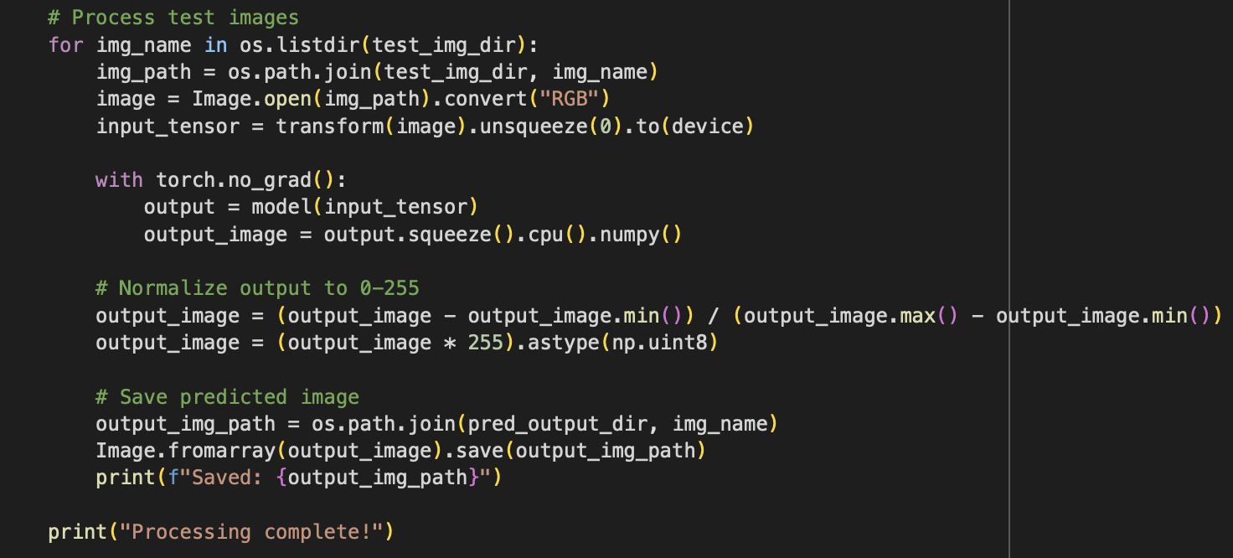
STEP-12- TESTING THE DATASET
Folder “predicted_output” is successfully made containing output images

Slide 23
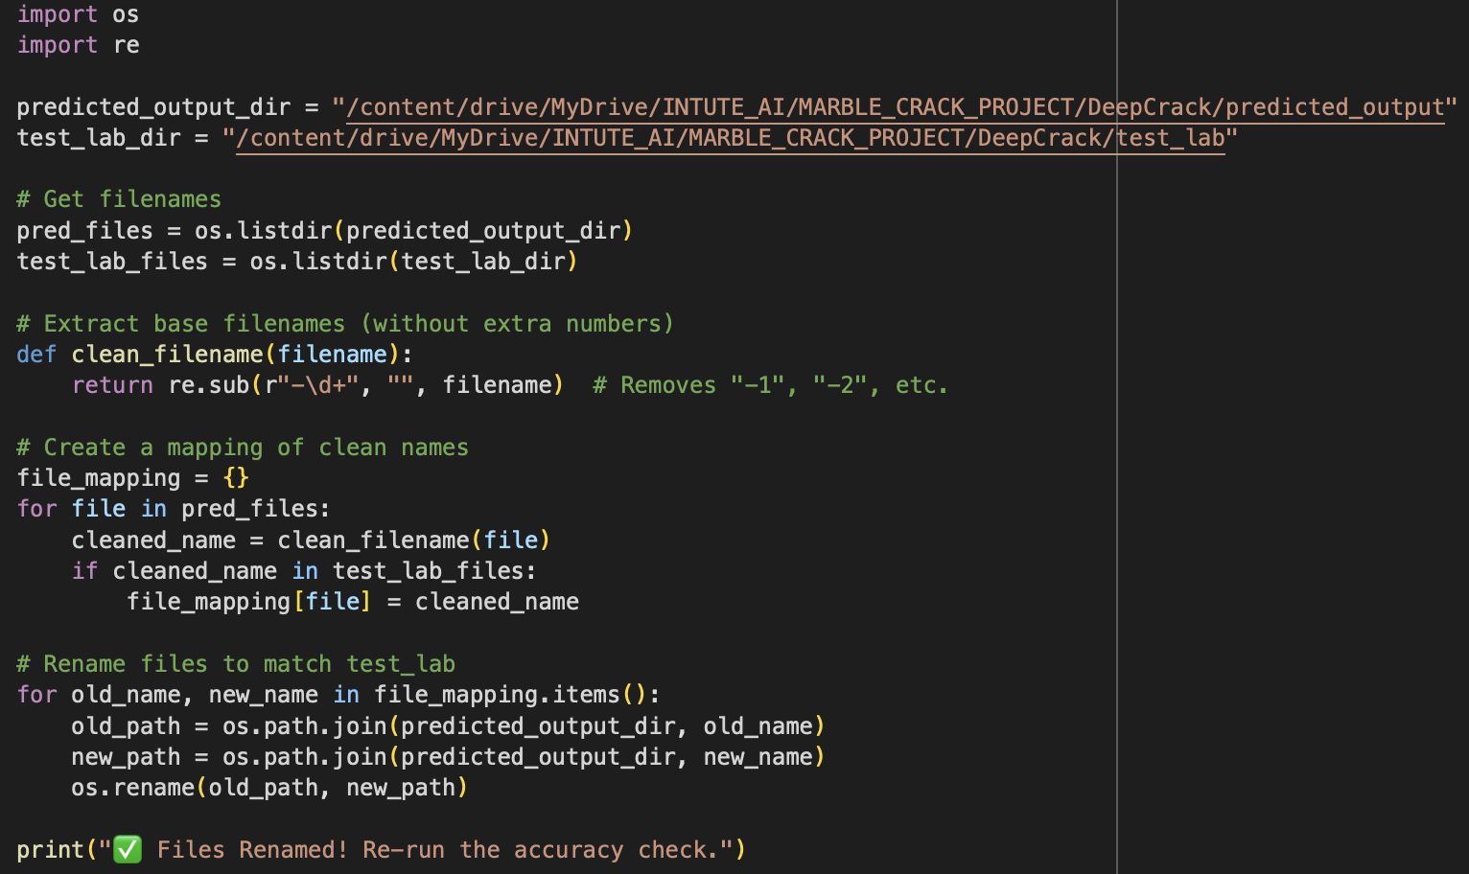
STEP-13- COMPARING THE PREDICTED TO THE ACTUAL IMAGES
Renaming the output images to match with the actual images names.

Slide 24
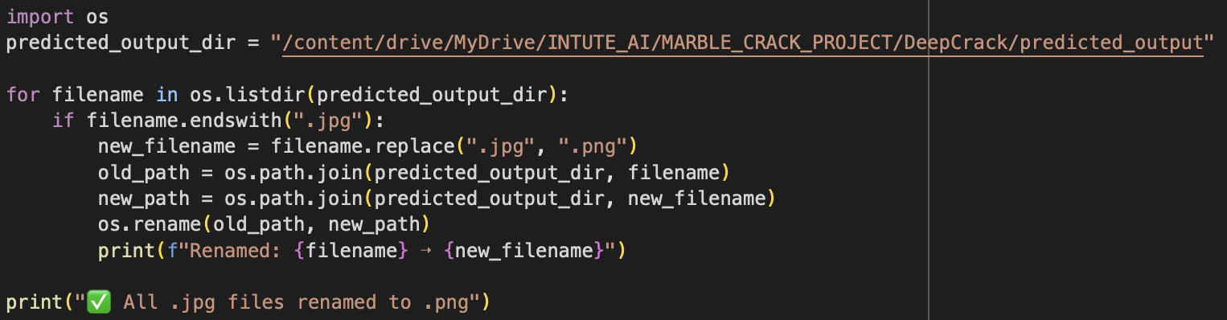
b) Converting the output images from .jpg to .png

Slide 25
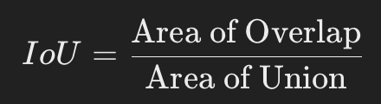


c) Comparing the predicted to the actual output images
d) Computing the IOU and Dice scores
THE RESULTS COMING OUT ARE:-

